Slide 1
MEALMATES

Slide 2
Agenda
Introduction
Problem Statement
System Design
Key Features
Technology Stack
Target Audience
Demo
Future Plans

Slide 3

introduction
MealMates is a revolutionary app designed to simplify meal planning and dietary management. It helps users plan meals effectively while aligning with their health goals and dietary preferences. This section introduces the purpose and vision of MealMates, focusing on how it makes healthy eating easier and more personalized for everyone.

Slide 4

Problem statememnt
This section highlights the challenges people face in meal planning, such as time constraints, managing dietary preferences, and meeting health goals. It also points out the lack of effective solutions in the market that address these pain points comprehensively. MealMates aims to fill this gap with its innovative approach.

Slide 5
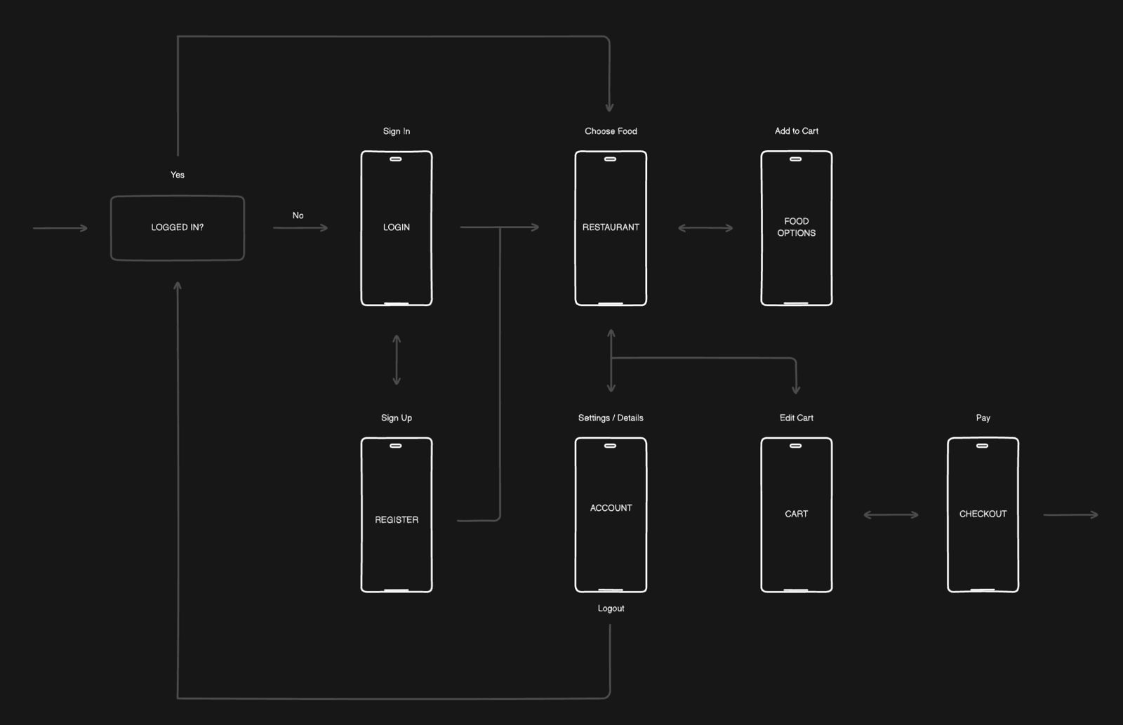
System design

Slide 6
Technology stack
MealMates is built using robust technologies such as Flutter for a seamless cross-platform experience and Firebase for secure authentication and database management. The app integrates APIs for recipe databases and nutritional analysis to provide reliable and efficient functionality.

Slide 7
Target Audience
MealMates caters to busy professionals, health-conscious individuals, and people with specific dietary needs such as vegans or those with gluten intolerance. Fitness enthusiasts and families looking for convenient meal planning solutions can also benefit greatly.

Slide 8
Target audience

Slide 9
DEMO
Now, my team will walk you through the MealMates app and demonstrate its functionality, showcasing how users can browse food items, add them to their cart, and place orders.

Slide 10

Future plans
Enhanced Personalized Food Plans: More advanced meal plans based on user preferences, health goals, and past orders.
AI-based Meal Recommendations: Smarter meal suggestions using AI based on user behavior and dietary needs.
Real-Time Delivery Tracking: Track orders in real time for a better delivery experience.
Local Restaurant Partnerships: Partner with local eateries to provide exclusive food options.
Fitness App Integration: Sync with fitness apps to help users manage nutrition alongside their fitness goals.
These updates aim to make MealMates even more personalized and user-friendly.

Slide 11
THANK YOU
Syed M. Sarim Ahsan
Rao Dayan Atif

